Slide 1
Jc hillel asb: glimpses
Dominican Republic Service Trip with
Centro Cultural El Guanin, La Piedra
March 9-16, 2013

Slide 2
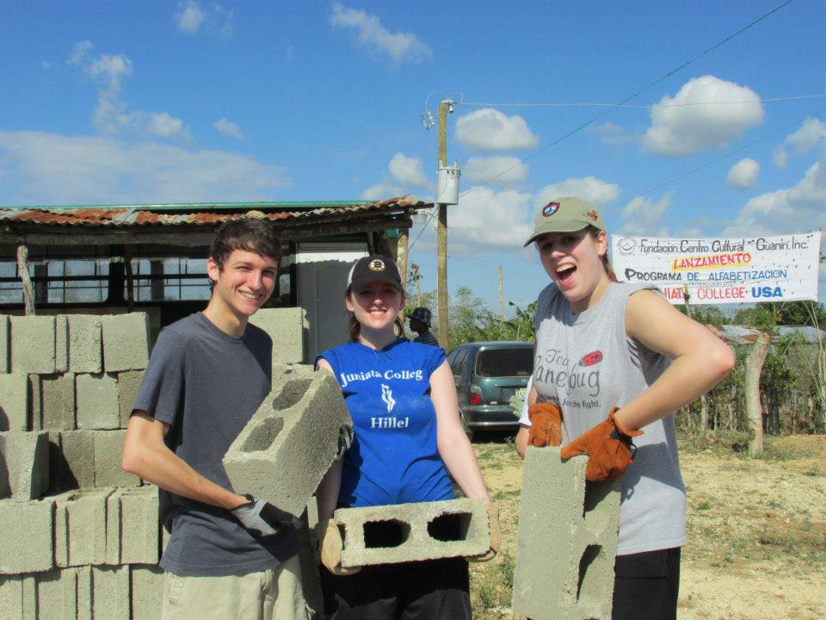
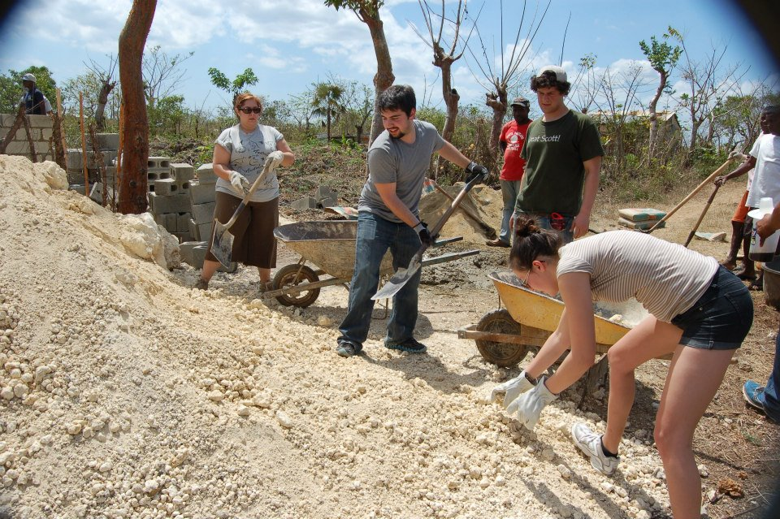
Constructing a new home for a Haitian refugee family
^ After!
Before:

Slide 3
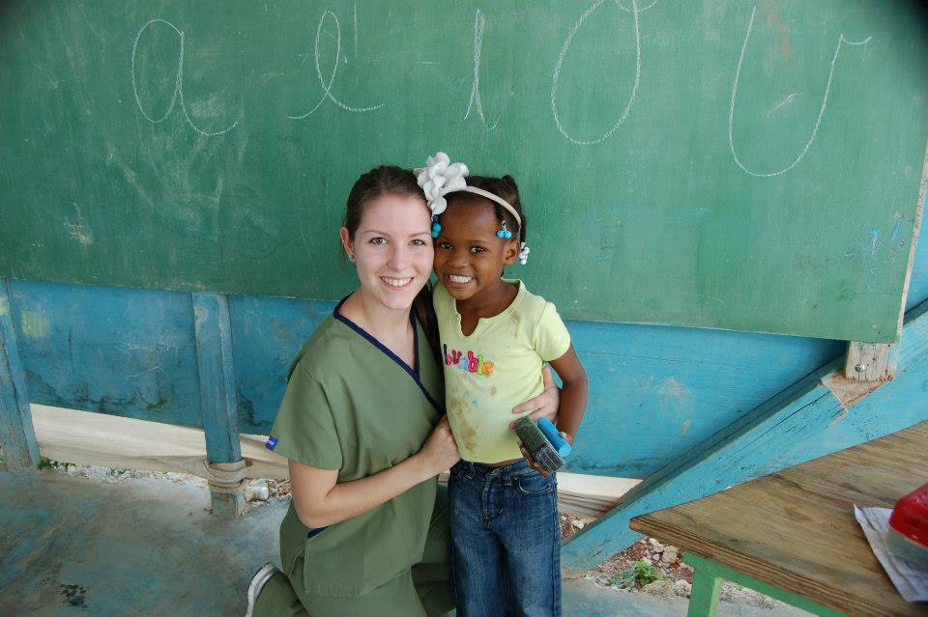
Teaching and entertaining kids

Slide 4
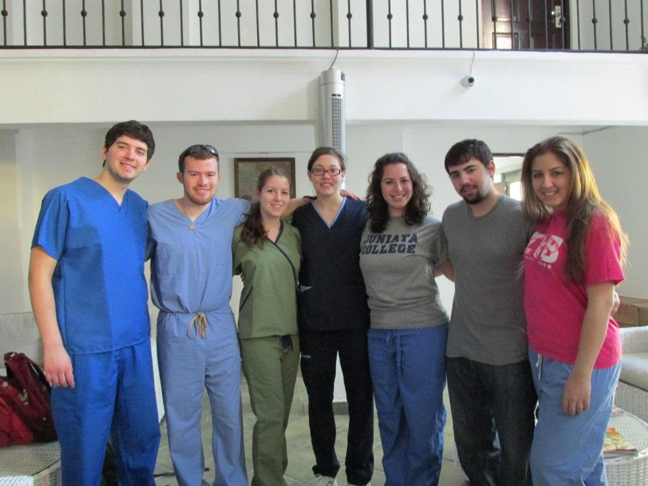
Medical inventory & training help

Slide 5
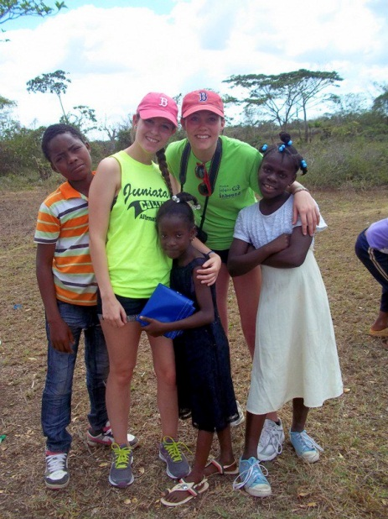
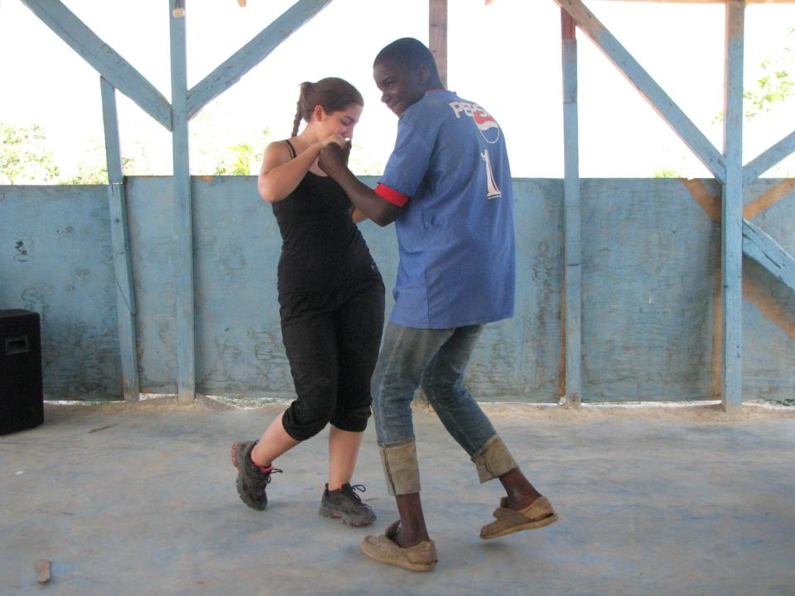
Cultural events and celebrations
Dominican dancing lessons
Baseball, top DR sport

Slide 6
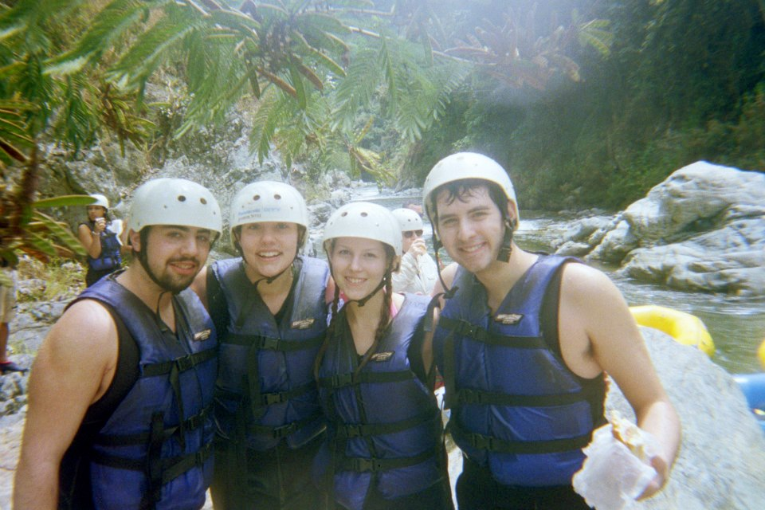
MORE!!!

Slide 7
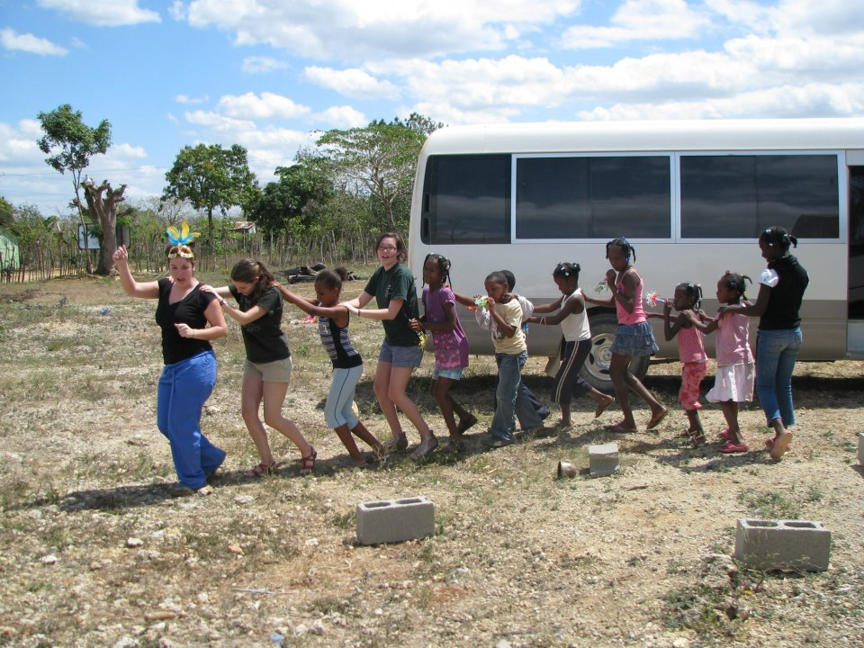

Slide 8
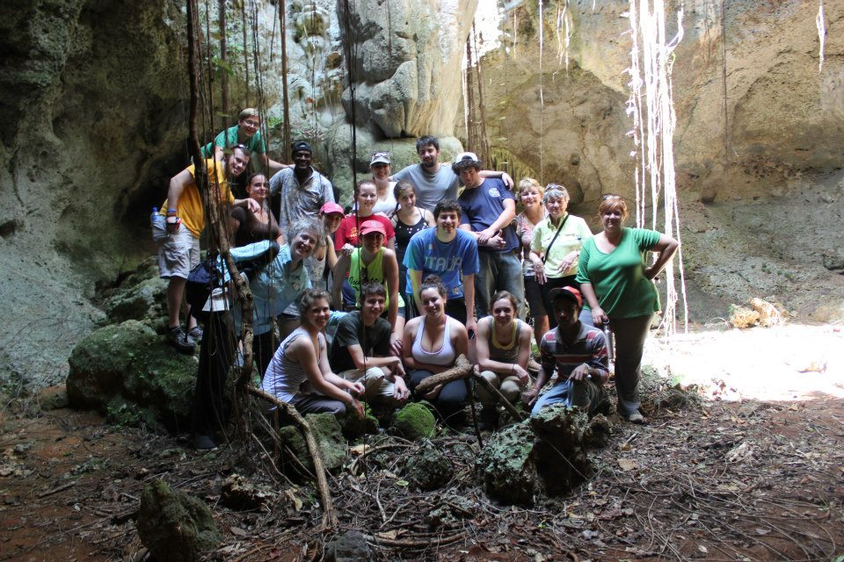

Slide 9
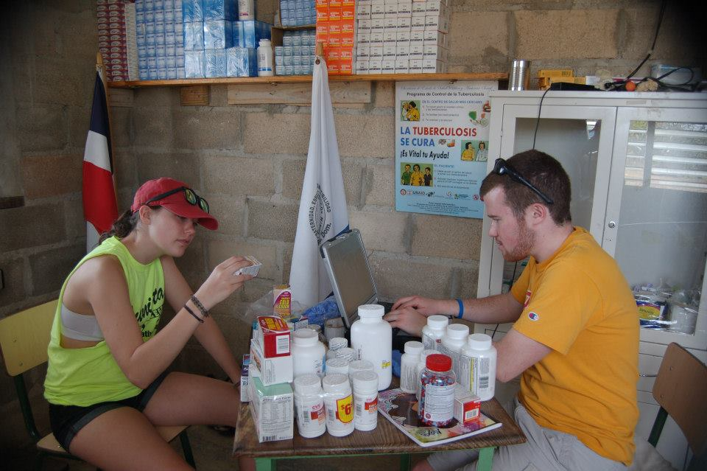

Slide 10
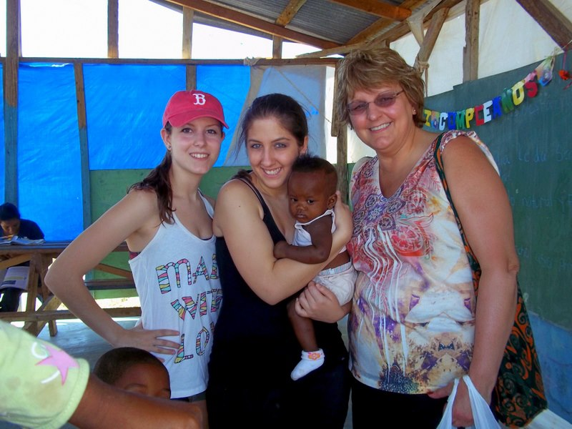

Slide 11
